Slide 1

Creating a Culture of
Welcome and Hospitality
Fulfilling the Vision Workshops
Office for Parish Life
Diocese of Scranton

Slide 2
Goals for tonight:
Explore how Welcome and Hospitality are essential elements of a Catholic Christian parish.
Get you thinking about a next steps for your parish in this area.
Notes:
Goals for tonight:
Introduce you briefly to your role as a CT member
Introduce you to Welcome and Hospitality as an essential element of a Catholic Christian parish.
Get you thinking about a direction for this parish.

Slide 3

Opening Prayer
There is no fear in love, but perfect love casts out fear; for fear has to do with punishment, and whoever fears has not reached perfection in love. We love because he first loved us. Those who say, ‘I love God’, and hate their brothers or sisters, are liars; for those who do not love a brother or sister whom they have seen, cannot love God whom they have not seen. The commandment we have from him is this: those who love God must love their brothers and sisters also.
1Jn 4:18-21
How do you respond to feelings of fear, suspicion and anxiety about your neighbor?
Notes:
Find READER
Focus: Let us become aware of God’s invitation in this very moment –to know that God loves us, sustains us, has good things planned for us. God looks with mercy on us no matter our sins or our baggage. God welcomes us in love.
Reading
Reflection question for discussion → we are talking tonight about a radical notion, Hospitality, radical because God welcomes all and demands that we do the same!
Sing “Enter” SONG SHEETS

Slide 4
The Importance of Hospitality
Remember a time you felt welcomed.
How did it change you?
Notes:
Share with the person next to you
Share with large group
ME: draw attention to why it is important → These are fundamental needs of a human being: Arabic word for human being is “one who lives in community”

Slide 5
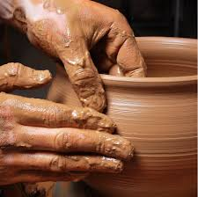
Hospitality Toolkit: Shaping the Future of Parish Life
History
Content
Notes:
History of the Toolkits
Visit the toolkit and walk through it

Slide 6


Belonging:
Our Hunger for Home
Sometimes you wanna go
where everybody knows your name
and they’re always glad you came.
You wanna be where you can see
the troubles are all the same.
You wanna be where
everybody knows your name.
Notes:
Keep in consciousness the reason we need to be hospitable is the deep down longing in everyone’s heart to belong.
Remember this song? (PLAY 38 seconds to 100 seconds)
1st need for millenials (before belief and behavior) – What am I talking about?

Slide 7
For the last few centuries…
Belief
Behavior
Belonging
Notes:
“For the last few centuries, Western Christianity offered faith in a particular way. Catholics and Protestants taught” that these happened in this order: 1) Belief, 2) Behavior, and then 3) Belonging. We were baptized as infants and taught catechisms. We were brought into Church practices and eventually, between 7 -15, confirmed, officially and completely belonging. Bass 201

Slide 8
Jesus did it this way…
Belief
Behavior
Belonging
Notes:
This is different than Jesus’ method: He began by inviting people to belong to the community of His disciples. There they learned how to behave by following the Way. This behavior in turn created a new way of seeing, a new set of beliefs. Bass 207
Consider the “Bread of Life Discourse” in John 6. When Jesus explains that people must eat his body in order to be saved, many leave. Jesus turns to the disciples and asks if they will go too. Peter says in reply, “Lord, to whom can we go? You have the words of eternal life. We have come to believe and know that you are the Holy One of God.” (John 6:68-69)

Slide 9

Revelation = Relationship
Revelation
Evangelization
Hospitality
Revelation = Body of Knowledge
What Is Revelation?
Notes:
Some of this is because of how we look at how we come to know God. We call this Revelation and the way we picture it has a big impact on how we “do” Church. For several centuries, as a result of the Enlightenment, the Church saw Revelation as the activity of us studying or learning about God. Revelation was therefore a Body of Knowledge to be mastered. So we wrote catechisms and memorized 160 questions for Confirmation and saw even God as something to be studied.
But Vatican II reminded us that Revelation is first and foremost about God reaching out to us to have a relationship with humans, with us. When we come to mass, our main focus is not wondering how late we can be and still count it as meeting our Sunday obligation. It is to fall further in love with God (and with each other). It’s about relationships. When we are called to evangelize, it’s not to set all those wrong people straight. CLICK It’s to share the Good News that God is in love with each and everyone of us! Again, it’s about relationships.
And what is more essential to relationship-building than hospitality? So I suggest to you that Hospitality is needed to make possible the in-breaking of God into the lives of others. It allows for what Sherry Weddell calls the first threshold of conversion, which is Trust. If the trust doesn’t happen, I will not ask questions, I will not engage, and I certainly will not make a commitment to the God I cannot see, if the people I can are rude and cliquish.

Slide 10
Welcome in the Bible
Abraham &
Sarah
(ca 1800 BCE)
Three visiting angels –who knew?
Pleases God →Promise of Isaac’s birth.
“Entertained angels.”
Ps 23: 5-6
You prepare a table before me
in the presence of my enemies;
you anoint my head with oil;
my cup overflows.
Surely goodness and mercy shall follow me
all the days of my life,
& I shall dwell in the house of
the Lord my whole life long.
Notes:
Now that we have reflected on the need for welcome and belonging, let’s look at its spiritual roots in Scripture and Tradition:
Hospitality = value in Middle Eastern society as far back as the time of Abraham and Sarah (circa 1800 BCE) in Mamre (Gn 18: 1-8). 3 visiting angels bless Abraham and Sarah for their hospitality by promising them a son within the year. Granted, they had been promised descendants as numerous as the stars and the grains of sand already, but this generosity moves their covenant with God forward to the definitive promise of Isaac’s birth. Abraham and Sarah did not initially know who the three visitors were; the fact that they welcomed anyone seems particularly pleasing to God. → Encouragement in Heb 13:2 : “Do not neglect to show hospitality to strangers, for by doing that some have entertained angels without knowing it.”
In Psalm 23, the Lord models hospitality in a way that gives great comfort to the singer. The singer finds safety, security, food, honor and distinction, forgiveness, goodness and a home with the Lord. Who has not read this and thought, “Oh, I would love to have that!”

Slide 11
Divine Expectations
Then the king will say to those at his right hand, “Come, you that are blessed by my Father, inherit the kingdom prepared for you from the foundation of the world; for … I was a stranger & you welcomed me… “
Then the righteous will answer him, “Lord, when was it … that we saw you a stranger & welcomed you?”
And the king will answer them, “Truly I tell you, just as you did it to one of the least of these
who are members of my family, you did it to
me.” Mt 25:34-40
Notes:
Throughout Scripture God models hospitality and pointedly calls on us to show it.
Perhaps most pointedly in this passage. – only thing required for entrance into heaven!
FINISH 6:27

Slide 12
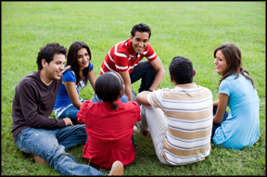
Foundations:
A. Seeing Christ in Others
“Very truly, I tell you, whoever receives one whom I send receives me; and whoever receives me receives him who sent me.”
Jn 13:20
“For where two or three
are gathered in my name,
I am there among them.”
Mt 18:20
Notes:
2 interior efforts needed for hospitality →A.
Read passages and emphasize the power of each statement – not “like” but really Jesus

Slide 13
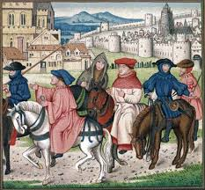
Foundations:
A. Seeing Christ in Others
All guests who present themselves are to be welcomed as Christ, for he himself will say: I was a stranger and you welcomed me (Mt 25:35).
-Rule of St. Benedict
Notes:
This idea of seeing Christ in others continues thru C history
Benedict (6th century)

Slide 14
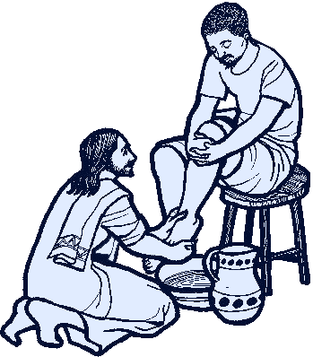
Foundations:
B. Being Christ for Others
“So if I, your Lord and Teacher, have washed your feet, you also ought to wash one another’s feet. For I have set you an example, that you also should do as I have done to you.”
-Jn 13: 14-15
Notes:
2nd interior action –so powerfully summed up at Last Supper

Slide 15


Foundations:
B. Being Christ for Others
Christ has no body but yours,
No hands, no feet on earth but yours,
Yours are the eyes with which he looks
compassion on this world,
Yours are the feet with which he walks to do good,
Yours are the hands, w/ which he blesses all the world.
Yours are the hands, yours are the feet,
Yours are the eyes, you are his body.
Christ has no body now but yours. -St. Teresa of Avila
Notes:
Beautifully spelled out by St Teresa (16th century)
Prayerfully consider –reaction?

Slide 16
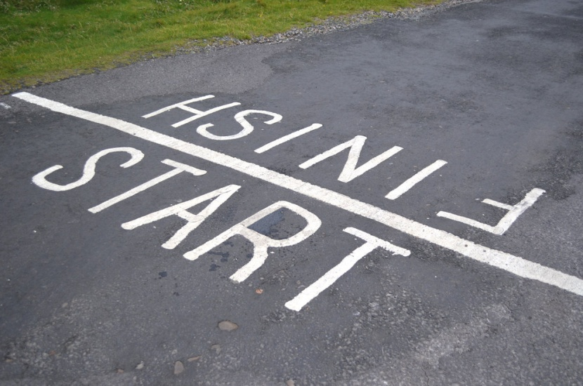
Hospitality Evangelizes
We greet Christ in one another long before we receive him in the sacrament of Communion.
-Ferrell & Turner
Those on the margins… and those in the pews
Notes:
More recently, in their lovely book, A Guide for Ushers and Greeters, Kerrie Ferrell and Paul Turner remind us that “We greet Christ in one another long before we receive him in the sacrament of Communion.” They are speaking particularly about the value of those ministries, but I would like to broaden this idea. If we are not bringing Christ to people in our day-to-day lives, the Eucharist will not be effective.
So we come full circle: Hospitality evangelizes. If I can be Christ for others, they can begin to hear the Good News. They can begin to have a relationship with God.
And this Good News is needed both by those who are not connected with our church and by those who are coming weekly. Everyone needs to hear the Good News that God is wildly in love with them.

Slide 17
Ingredients of Hospitality
Access
Lifestyle
Ministries
Hospitality
Notes:
To help you organize your thinking around a rather huge topic, we have divided Hospitality into 3 segments. All are needed, but Rome wasn’t built in a day. So as I walk through the following information, be affirmed in what you are already doing and think about what is a manageable next step.

Slide 18

Lifestyle
Welcome in Everything
Notes:
Lifestyle = an overall attitude that is needed. If all I said is true about God’s own hospitality and your need to be hospitable, then hospitality is not just an isolated ministry for a few outgoing people. It is everyone’s ministry by virtue of their baptism.

Slide 19
“How Welcoming Am I?”
A welcoming presence in my parish?
Welcoming in my facial expressions/mannerisms?
I see Christ in others. Do others see Christ in me?
Greet people as I approach the church & in the gathering space?
Speak positively about the Catholic Church, my parish, my pastor, etc.?
Inclusive?
Participate in the Mass to give glory to God and a good example to others?
Extend Christ’s peace to others, looking them in the eye and acknowledging everyone around me?
Notes:
Part 1: My own welcoming lifestyle
Here’s a personal inventory about your behavior as a member of the parish.
As statements unroll on the screen, answer in your heart.

Slide 20

Personal Formation
After Mass & throughout the week, strive to cultivate a hospitable heart. Work on the demeanor you will bring with you to church. This works both ways. Your service at church will also help you keep a kindly spirit at home and at work throughout the next week.
-Ferrell & Turner
Notes:
Ferrell and Turner propose in their Guide to Ushers and Greeters the following. READ SLIDE. So I need to raise my awareness of how I am welcoming in all aspects of my life.
It’s that being Christ and seeing Christ overflowing beyond church property and making Eucharist possible.
It’s how you evangelize

Slide 21

The Parish’s Role
Create a context for hospitality:
Most parishioners do not know that they should be welcoming.
Part of discipleship
How to?
Homilies
Info Series: in bulletin and/or brief talks at mass
Social media: “I was the welcoming face of Jesus.” or “I saw the welcoming face of Jesus.”
Reflection questions: in pew or home
Notes:
Part 2: The Parish’s Welcoming Lifestyle
Not only do I need to be a welcoming individual, our whole parish needs to be hospitable
Let’s reflect on our parish as a welcoming place and ways we can bring hospitality to our ministries
Walk thru slide
Segue to next slide with discussion questions.

Slide 22

Discussion Prompts
What does our parish look like thru the eyes of a visitor?
What are we doing now to welcome visitors?
Do you know the names of those who sit by you?
Recall a time you felt welcomed in a strange place. What made you feel that way? Are you and your fellow parishioners doing that now?
What is one thing you can do to help everyone feel at home in our parish?
If you imagine our parish as a model of hospitality, what 3 things would be key?

Slide 23
The Welcoming Backdrop
Elements of Welcome Culture | Welcoming? | Work on? | If so, when?
Web presence
Office staff aware of being 1st contact
Parish office open for day-time workers
Parishioners aware of role
Outsiders can find/ understand parish info
All liturgical ministers are welcoming
Visitors are recognized and included
Parish frequently a presence at community events
Notes:
20 Minutes
10 Min BREAK (7:45-7:55)

Slide 24
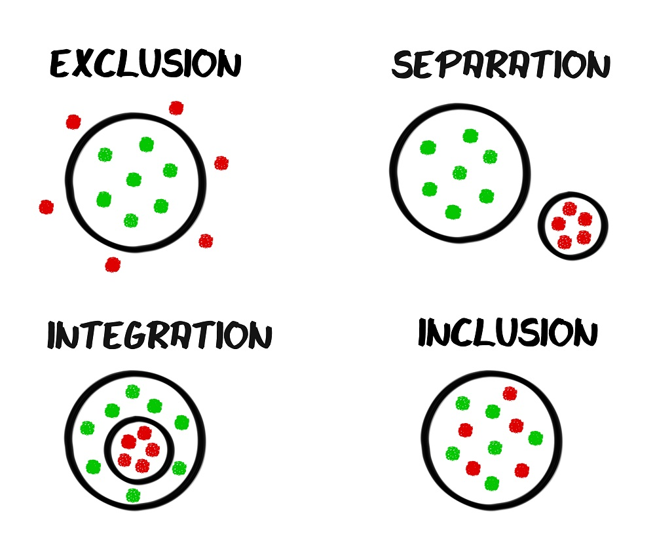
Inclusion & Accessibility
Notes:
HAM IT UP: Your parish’s physical plant is speaking? Can you hear it?
Perhaps you cannot because you have many experiences with it and the memories of all those experiences are louder in your head.
But what if I am a newcomer? What would I hear?
Your physical plant speaks loud and clear to newcomers or infrequent visitors and it tells them who is welcome and who is not.
If I am elderly or disabled, can I get in?
If I am elderly or disabled, can I serve or only watch?
If I am new, can I find an open door or figure out how to get inside?

Slide 25
Is Our Parish Welcoming?
The parish is easily identified w/ name & mass times visible from road.
Church rectory & parking lot are well marked & easily identified.
Rooms & buildings are clearly marked.
Buildings are wheel-chair accessible.
Parking spaces for persons w/ disabilities
Large print missalettes & listening devices available
Hospitality ministers greet & assist people at all masses.
New parishioners are introduced to the community.
Our parish includes those who speak other languages.
We welcome young children, those w/ special needs & persons of all ethnicities.
We reach out in times of grief.
Notes:
10 minutes

Slide 26

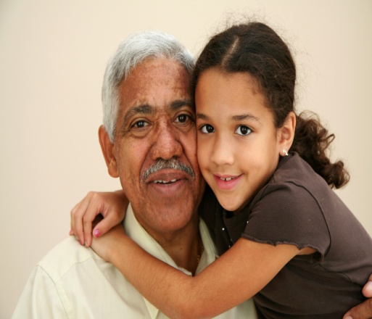
How do we improve?
Campus Tour by Buildings and Grounds Team, Disabilities Advocate and Parish Staff
National Catholic Partnership on Disabilities (www.ncpd.org)
Surveys in the Toolkit
Survey your parishioners

Slide 27

Particular
Ministries of
Hospitality

Slide 28
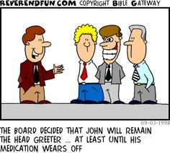
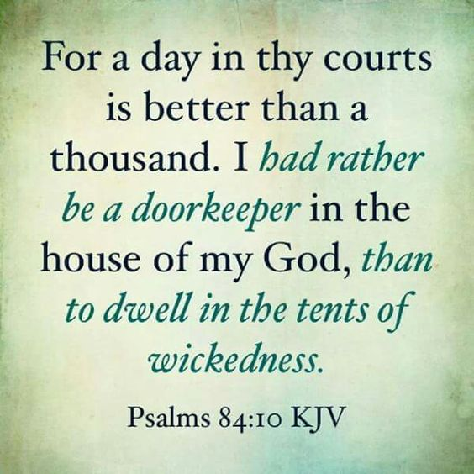
1. Greeters & 2. Ushers
Notes:
There are also formal ministries that a parish can consider. Each one adds to the welcoming atmosphere of the parish.
Training available in the Liturgical Ministry Training binder.
I will also be updating the Hospitality chapter within the next week or 2 and posting it on the tool kit.
I can also be called on for some training or “refreshing.”

Slide 29
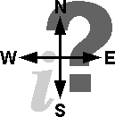
Other Ministries of Hospitality
4. Information:
Join parish
Get mass cards, sponsor cards, etc.
Any info they would have had to come to office for
3. Parking:
Team directs traffic
Helps people find spots
Indicates handicap parking
Knows street parking rules
Especially useful at masses with large crowds
→Clarity keeps potentially sinful area
flowing smoothly

Slide 30
5. Fellowship
Develop & lengthen people’s time/relationship →food/drink & visiting time after mass
Room to mingle
NOT out of the way
Religious ed. parents while they wait
6. Bakers –provide a treat after special masses or at special parish meetings

Slide 31
7. Ministries Brochure/Fair
Belonging & Invitation
→ Each member of Body of Christ brings unique gifts
Brochure:
Committee members comfortable w/computer
Pastor’s letter of welcome
Contact info for parish office & staff
List of all programs and ministries offered by parish w/description, name of person in charge & contact info
Ministry fair:
1-2x/year after masses
In church hall
Tables for each ministry to display
Reps to welcome, inform & sign up new participants
Freebies, drawings & flyers
Organizing committee invites all ministries
Notes:
Engagement Toolkit has good ideas for Invitation and Recruitment!

Slide 32
8. New parishioners
Folder w/ all parish info that would be helpful
  Census
  Ministry booklets
  Programs interesting to newcomers
  Electronic giving
  Parish mission statement and plan
  Do NOT fundraise
Visit/Call
Supper/Breakfast
  Multiple times/year
  Parish staff &/or parishioners sit with newcomers
  Share parish plan/programs & invite participation
Personally invite to parish events the first year

Slide 33

9. Sacramental Prep
Attitude of welcome
Meet people where they are
Baby-sitting service
Feed so evening meals are not an issue
10. Child Care

Slide 34
Ministries of Welcome
Ministry | Have it now? | Worth adding? | If so, when?
Greeters
Ushers
Parking Team
Information Table
Fellowship
Bakers
Ministry Brochure
Ministry Fair
New Parishioner Visiting Team
New Parishioner Event
Invite New People to events for a year
Welcoming Tone for Sacramental Prep
Child Care
Notes:
15 Minutes for survey and discussion

Slide 35

Writing Action Steps
Notes:
ACTIVITY worksheets:
Show example.
Invite them to work with other members of their team to create an action plan around one of the items that arose in their assessments.
Share plans with each other.

Slide 36
Heavenly Father,
You sent your Son as a model for hospitality & ministry.
May I have the courage to walk in his ways and serve your people.
Prepare my heart to love all who come through the door today.
Give me eyes to see their needs and gifts,
and grace to respond wisely to each situation.
I ask this through the same Jesus Christ our Lord. Amen.
-Ferrell & Turner, Guide for Ushers & Greeters

